Slide 1
DEVELOP AN OUTCOME L2
Evidence of Learning Template
YOUR NSN NUMBER HERE: 155765448
Project Title: Connect 4
YOUR NAME HERE: Avishai Lumanlan

Slide 2
Github /Drive link
https://drive.google.com/file/d/1reT0d4L74fyfa3YCVRFzQvXNM_Z4Uubl/view?usp=sharing
Trello board or PM link
https://alumanlan.monday.com/boards/1336010247
You MUST provide evidence showing how the problem has been decomposed, how the components have been developed and trialled, and of how they have been assembled and tested to create a final, working outcome.

Slide 3
Project management: Setup
Record evidence that you have setup project management tools to manage the development of your outcome.
Record evidence that you have chosen project management techniques to manage the development of your outcome.
Record evidence that you have setup/ chosen version control tools/techniques to manage the development of your outcome.
Explain why you believe that these tools and techniques are appropriate for the development of your outcome.

Slide 4
Why I Used Monday For Planning Out My Project
For planning my connect four project, I used Monday.com as it was easy to use and I was able to split the project into 5 major components and put a planned schedule which allows me to keep track of the progress I’m making week by week / day by day and whether I’m meeting the dates I’ve planned to finish on time. With also using Monday, I had to make sub-items for each major component that way every small part of the project will be worked on in a step by step manner by doing this. I could have used other planning softwares such as gantt or trello for example, but I decided to stick with Monday as it’s simple to use and easy to understand by having the ability to break down the major components of my project into smaller sub items. From my planner, I gave each major component of my game one week each and with a comment on the side to remind that I’ll code in the first 3 days then I’ll debug in the last two days in that week then the weekend is to check again that the code is fully operational and ready to take its next big step in completing the code.

Slide 5
How I Used Monday
2. While making my programme, I gave each major component of my game one week each for completion and with its feature of adding a comment to a particular component, I used it to keep myself and the planner updated. In terms of time management throughout a week, for example, while coding for the winning move iterator in my code, I spent 3-4 days purely on implementing this major component to my game. Then, I debugged and validated my entire updated source code in the last 2-3 days in that week to ensure that the code as of now is ready to move on so I can take the next major step of creating my project. Another feature I put to beneficial use in Monday in the management of my outcome is the status section of my plan where you are able to update to give a good idea on how close I am to completing a part of my code.

Slide 6
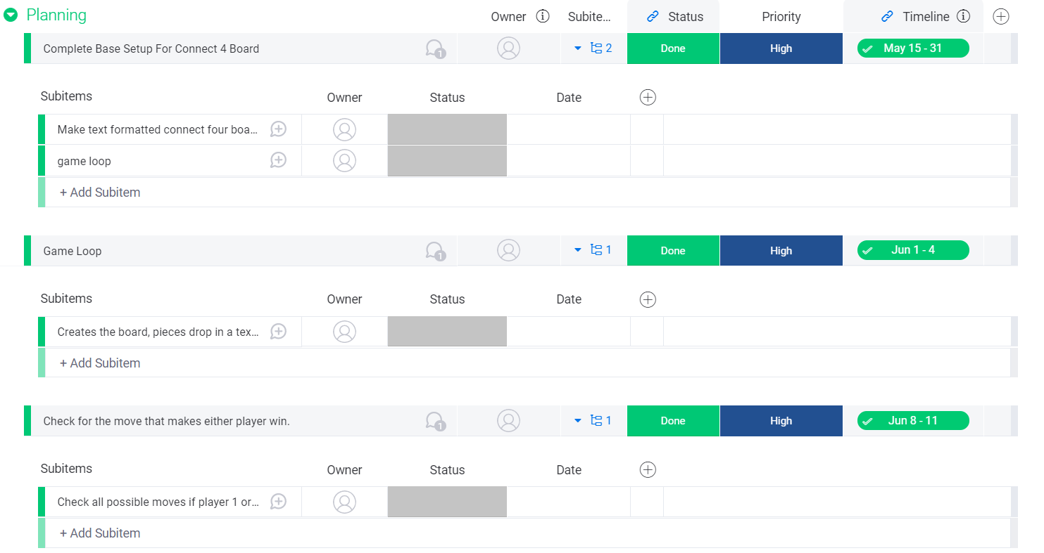
Record evidence that you have broken the outcome into smaller components.

Slide 7
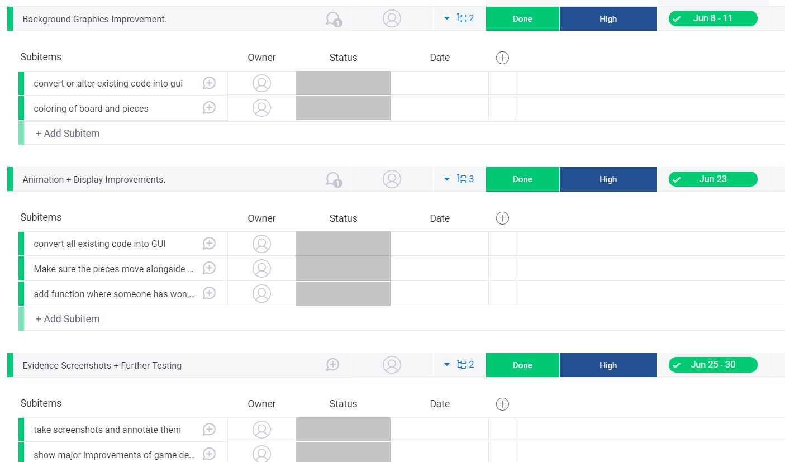

Slide 8
4. Overall, I believe that Monday was best suited for the planning of my project because of the basic features it gives such as subitems, work status and deadline to manage time efficiently. I could have used Trello for example, as it was also a good option, but I did not choose to use it because of the lack of feature of a schedule and update status unlike Monday. Even though Trello makes separate charts for each component, I still prefer Monday as I find it hard to manage time and I felt it’s much easier to keep up at whatever point I am up to whilst making my project.

Slide 9
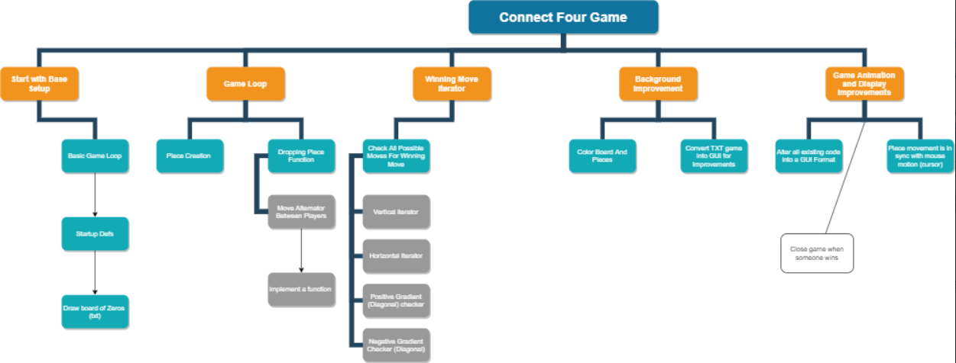
Decomposition of Outcome

Slide 10
Trialling components
Record evidence that you have trialled components. Show that you gathered information to inform your decision making.
Record evidence that you have trialled multiple components and have selected those most suitable.
Record evidence that you have used information from trialling appropriately to improve the functionality of the outcome.

Slide 11
Version Comparison
1.
Old (iterator error)- https://streamable.com/1xpmyo
Pygame Not Running Properly- https://streamable.com/v24ygi
Version 2 Improved- https://streamable.com/eibzhp
Final Version- https://streamable.com/zkqvkq

Slide 12
Between tall of the versions of my code, I decided to choose the versions that have errors to show that the development of my game never came smoothly, there were always errors. In the first version, there was an error where the game would end after 3 pieces in a row rather than four, then in the second, pygame would not run because I called variables that are meant to be coded inside of a def loop. With these errors, I was able to improve my code alot to a point where it’s really all my own work by the changes I’ve done. One change is making the board in a 8 by 8 instead of the standard 6 by 7 and changing the color from blue to orange for board color, blue and green for pieces in the game.

Slide 13
Code Improvements
Before and After

Slide 14
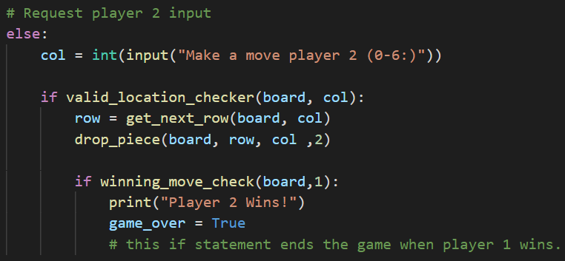
GUI INPUT CONVERSION (before in text format)

Slide 15

GUI INPUT CODE AFTER
I did this as I followed pygames documentation of position placement for a connect four game. In the col line, posx is divided by square (100px) as the values should equate to 7 instead of values like 700.

Slide 16

Major addition to code
Pygame mouse motion is to make sure that wherever the cursor is, the connect four piece follows with the cursor regardless if it’s either player 1 or 2.

Slide 17
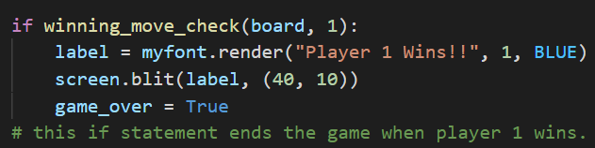
WINNING MOVE CODE CHANGE
I changed my winning move change to show a statement in the pygame GUI by defining a label tag.

Slide 18
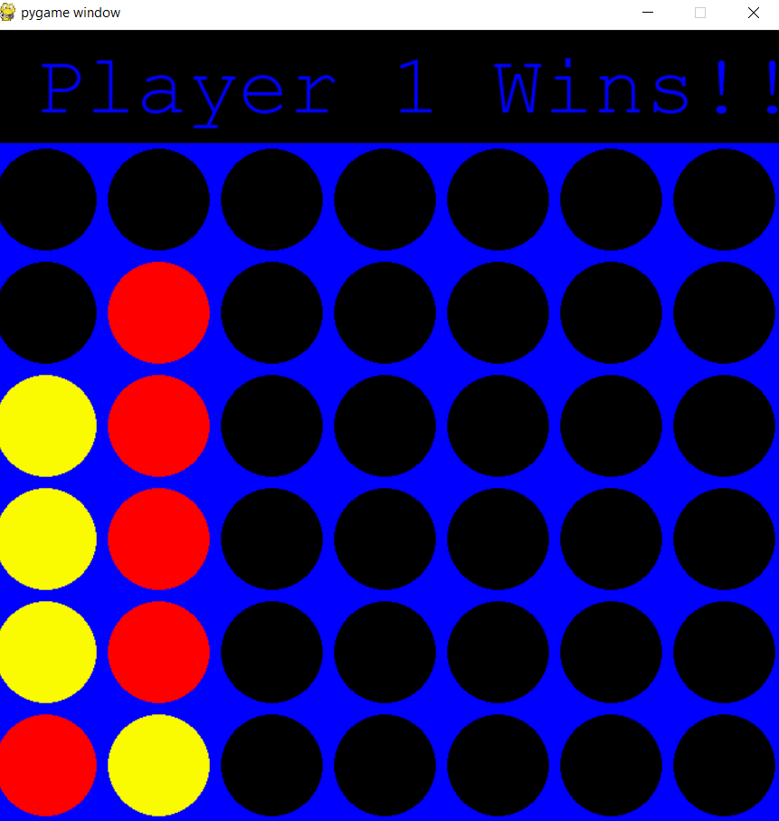
GAME WINNER FONT MINOR CHANGE IMPROVEMENT BEFORE
The font initially was monospace

Slide 19
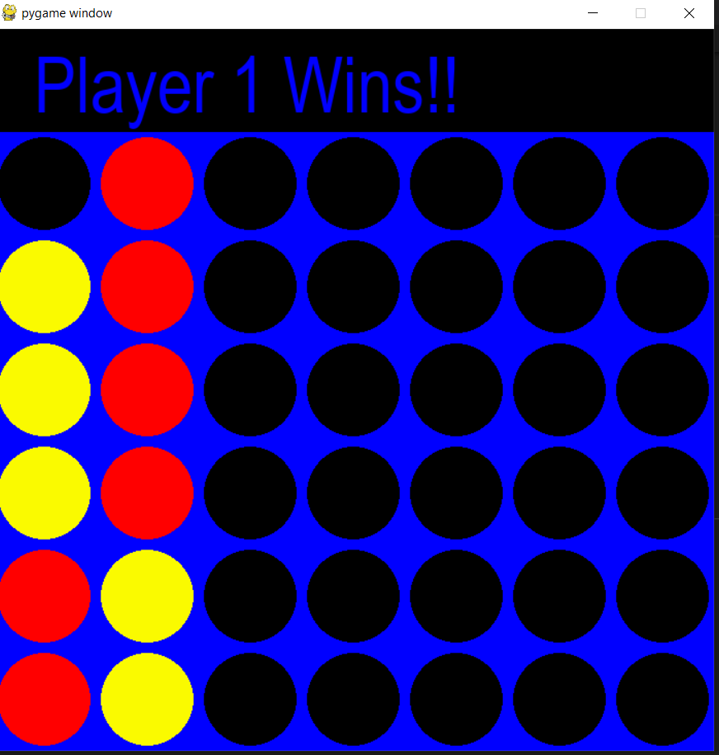
New Font Now (After)
I changed my font to a default arial because monospace may not be readable for all users, so I used a standard font instead. Another reason I used arial is because instead of using arial is that compared to monospace, arial is more thick which is more visible and readable.

Slide 20
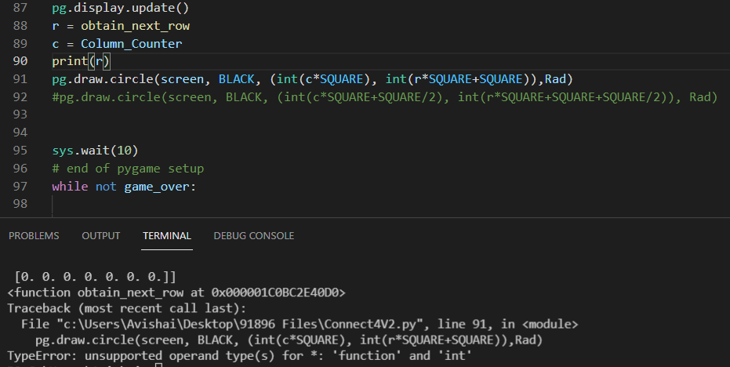
2.

Slide 23
3. Info Gathering (Error Collecting)
List of errors:
Calling variables outside a def loop

Slide 24
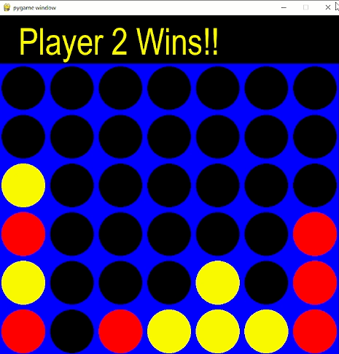
2. 3 in a row error

Slide 25
These two errors were the main errors that were setbacks found by my stakeholders for me as the errors would firstly, break the functionality of the code and it is not ethical. The reason that it’s unethical to leave error number 2 as it is does not comply with the way how real life connect four works. Error number 1 had more severe effects to my code as it would not successfully be converted into a GUI format game as pygame, the module im using for GUI keeps on closing itself because I called a variable that is meant to be defined inside a def loop for running pygame successfully. One more change I made from stakeholder feedback is to change my board and pieces to a different color so that it is coded and formed in a way that it’s to my own personal liking. The board was made orange, the black background stayed the same, then the pieces were changed from yellow and red to blue and green.

Slide 26
Testing outcome
Record evidence that you have tested your outcome.
Explain how the testing made sure your outcome functions as intended to meet its purpose and requirements.
Record evidence that you have used information from testing appropriately to improve the functionality of the outcome.

Slide 27
Video Recordings of Game Testing
https://streamable.com/ef628f
https://streamable.com/afmgex
https://streamable.com/cdblug
https://streamable.com/su0kav
https://streamable.com/1xpmyo
https://streamable.com/zkqvkq

Slide 28
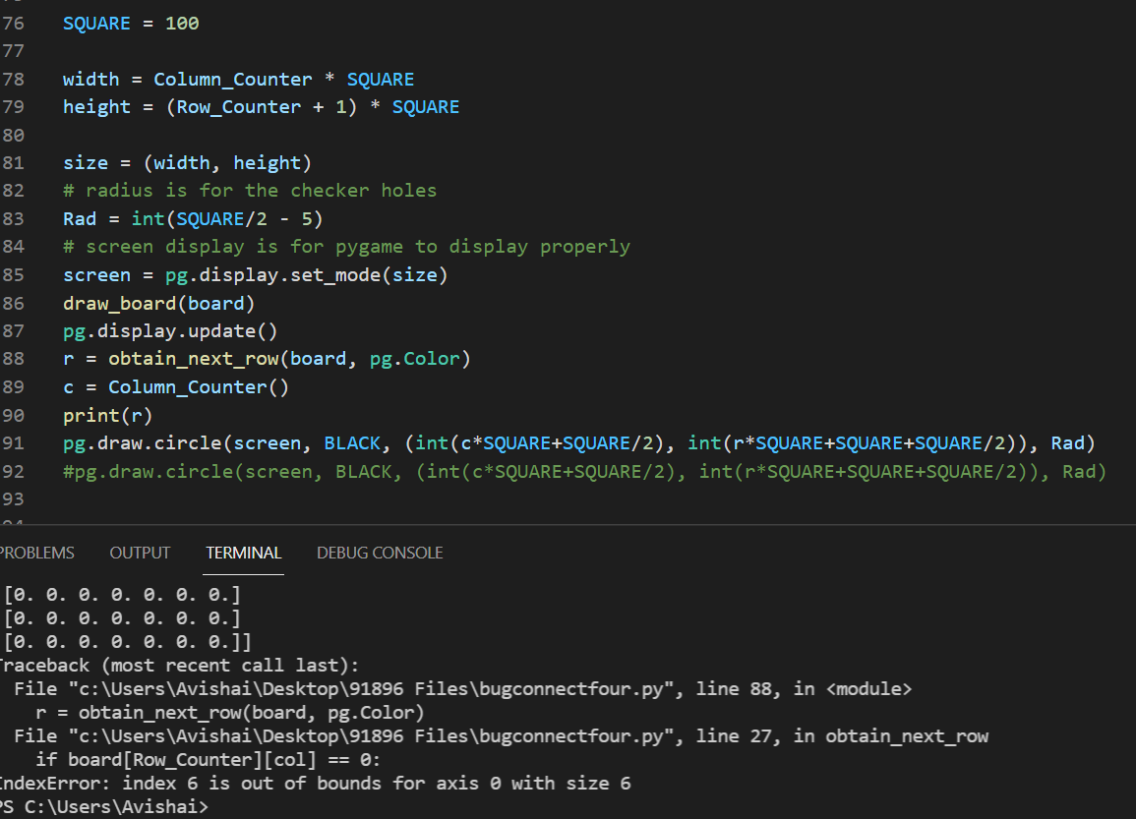

Slide 29
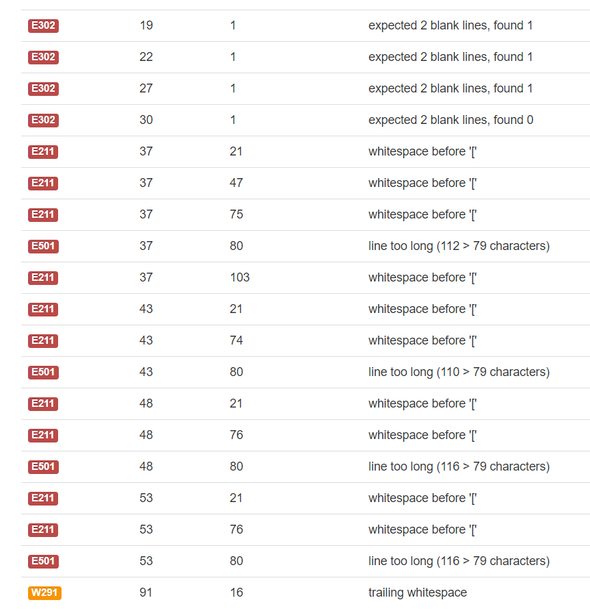
PEP8 Evidence
https://streamable.com/sacgza

Slide 30
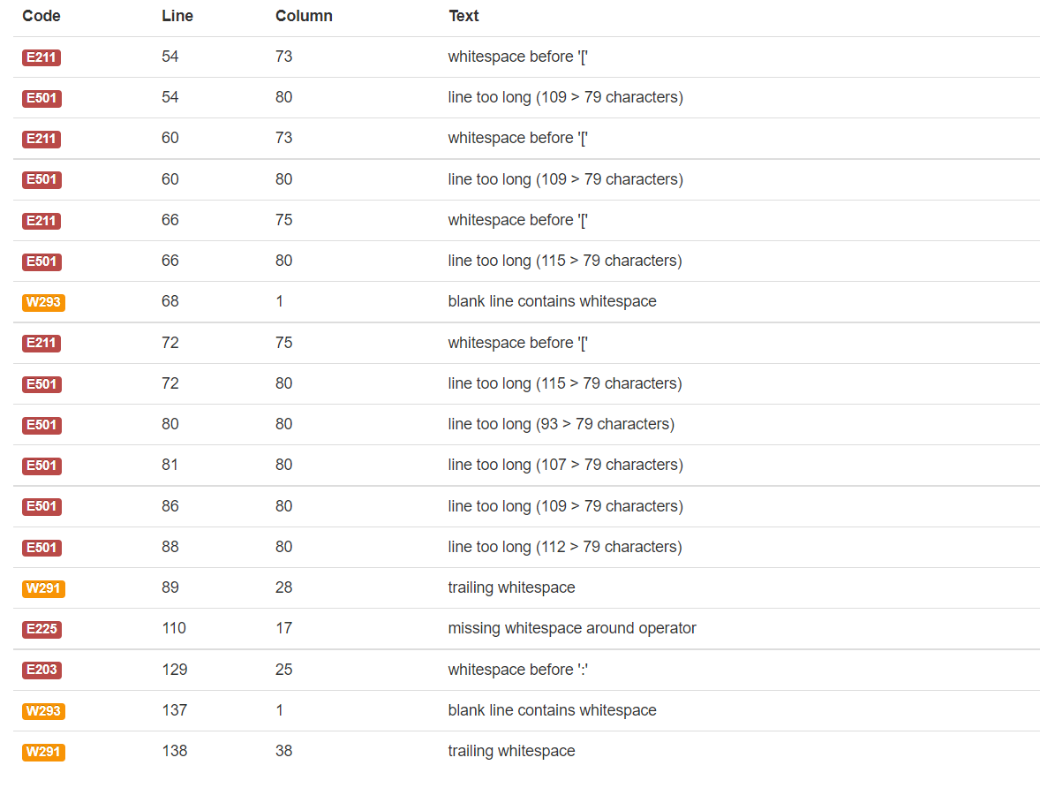
PEP8 VALIDATION (AS OF 6/24/21)

Slide 31
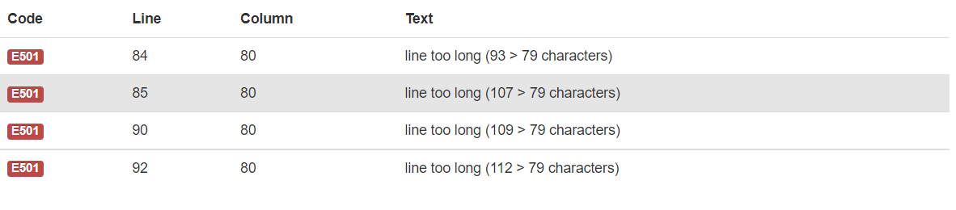

Slide 32
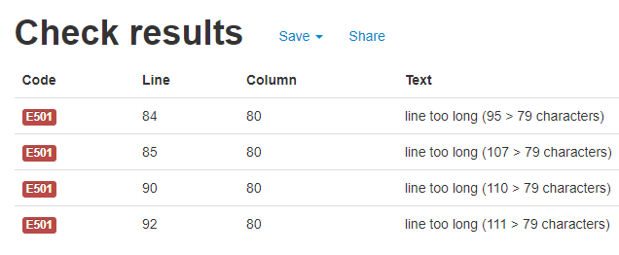

Slide 33
2. The process of testing helped me meet the requirements of my game because of code errors and convention errors were found so it meant that improvements were meant to be made and allowed me to meet its purpose where the game was formatted to my own personal liking and I want it easy to run and understand. One error that gave me a huge improvement was the unsupported operand type where I called variables that were meant to be defined inside a def loop which caused pygame, my gui formatter to stop from running. Another thing I had to make big changes to contribute in making my game better was the conventions (the way the game was made). With every major change, I consistently validated my code to make sure it is coded in a way that’s ethical and up to date.

Slide 34
b.
3.a. https://streamable.com/1xpmyo
C. https://streamable.com/afmgex

Slide 35
Project management: Applied
Record evidence that you have used your project management tools to manage the development of your outcome.
Record evidence that you have used your project management techniques to manage the development of your outcome.
Record evidence that you have used version control tools to manage the development of your outcome.

Slide 36
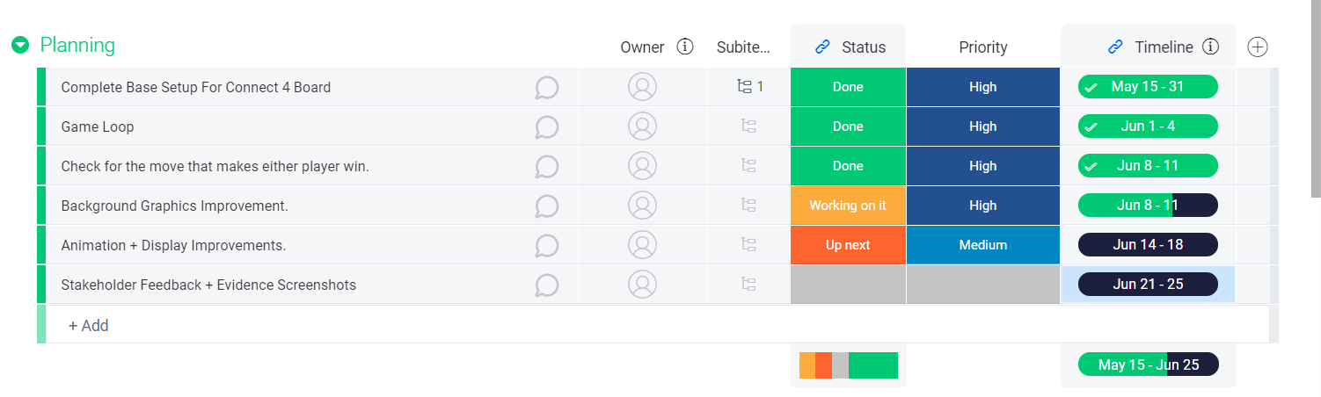
Plan As of 6/10/21
1.

Slide 37
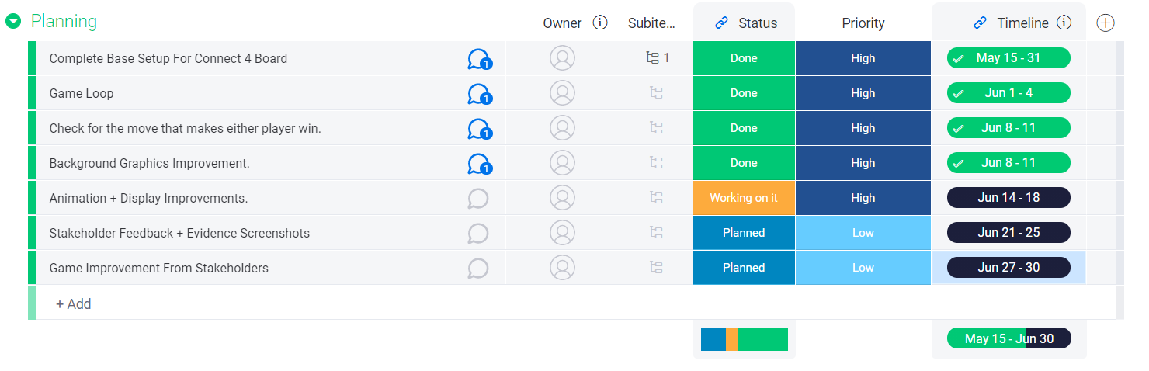
Plan As Of 13th Of June

Slide 38
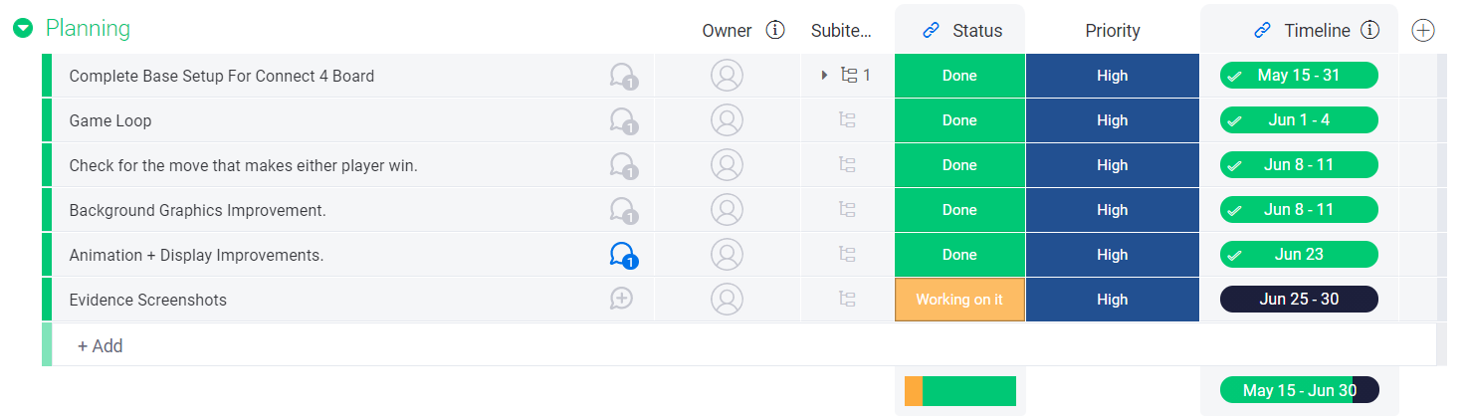
Planning In Final Stages

Slide 39
Here, all I’ve done was everytime I finish one major part of my project, I always update the status of that component as done or working on it or future steps with working on it as of now, marked as done is components that have already been finished and future steps is what’s after the part of the project I’m working on. Again, the project was six weeks long, so I gave myself one week for all the major components and for any spare time left is used to validate and trial for new features that I could implement into my project. And every weekend is used to ensure that my code is validated, error free and ready to take the next big step towards completion of my game.

Slide 40
2. Answered on next slide.

Slide 41
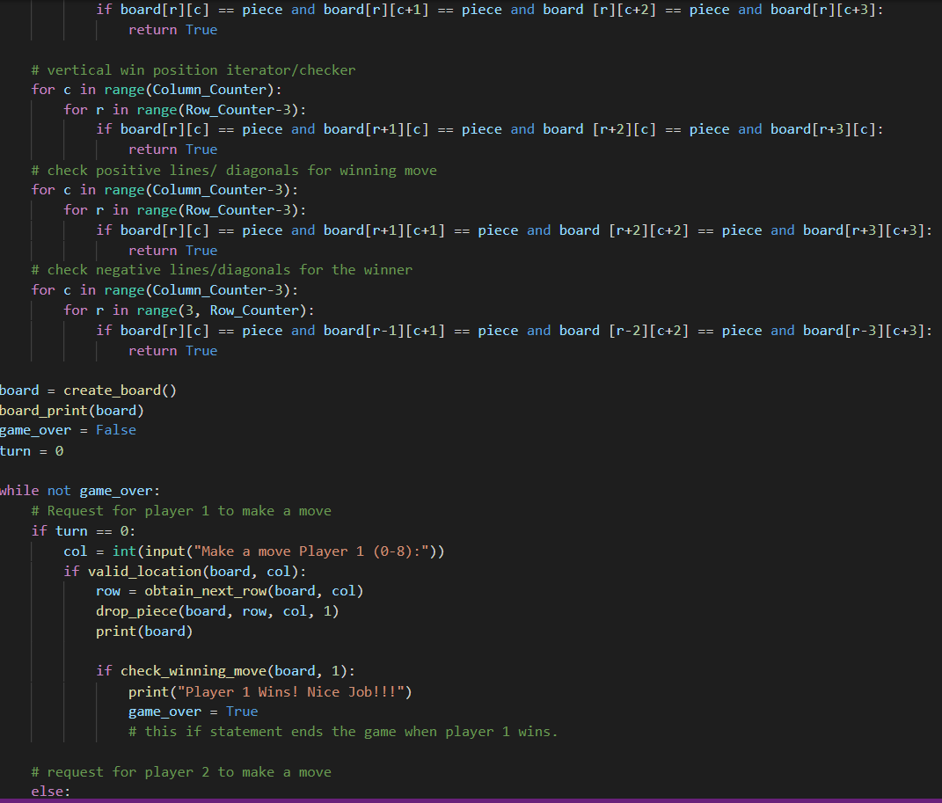
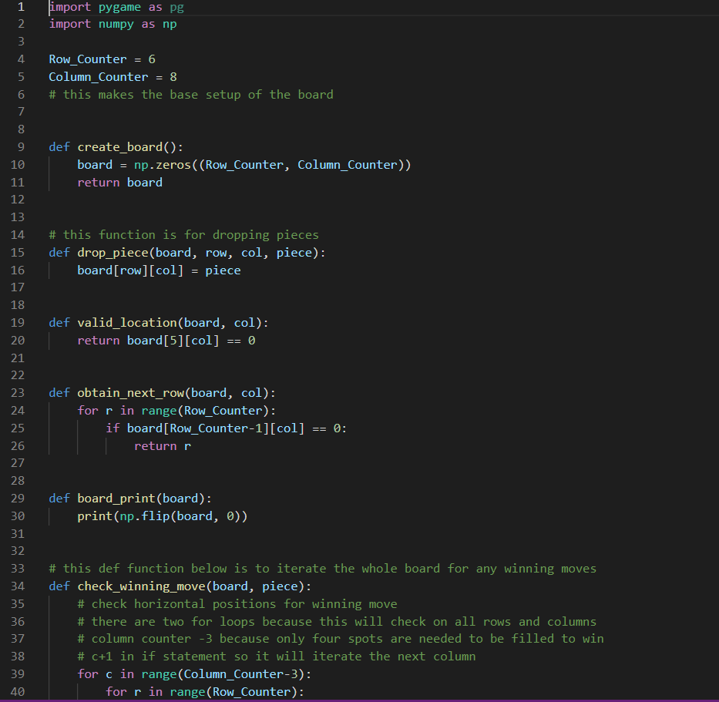
Code As Of 6/10/21

Slide 42
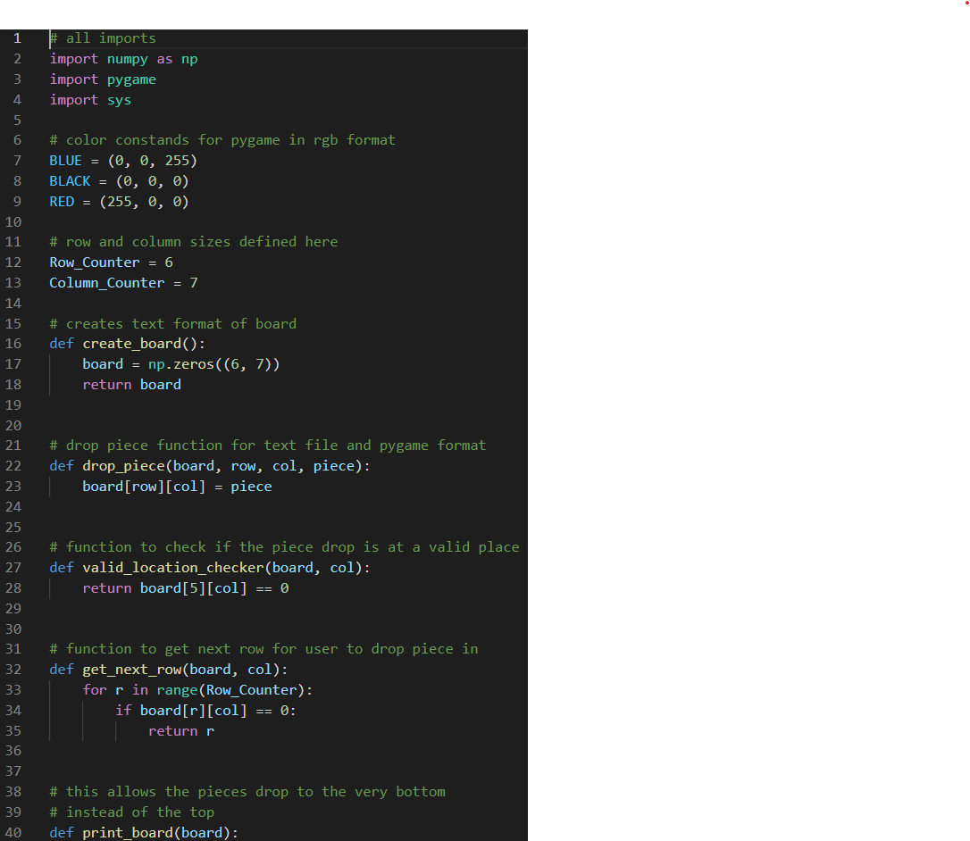
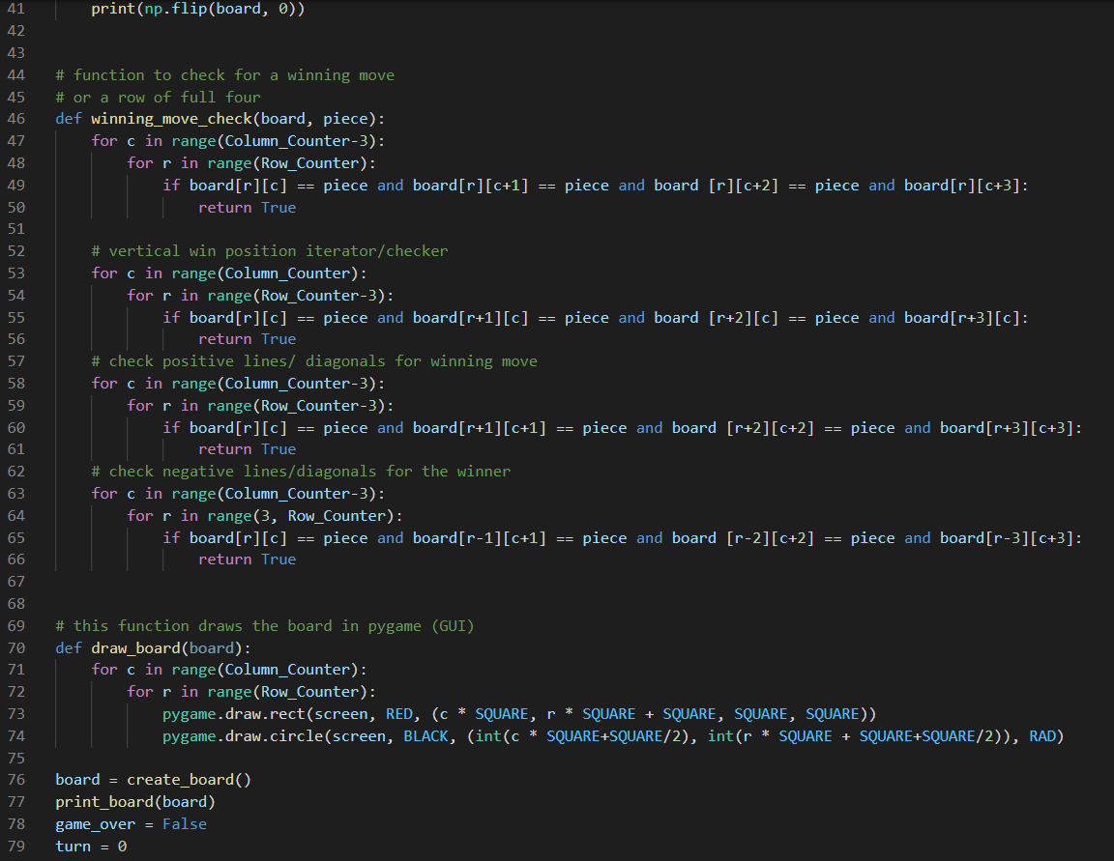
Code as of 13th of June

Slide 43
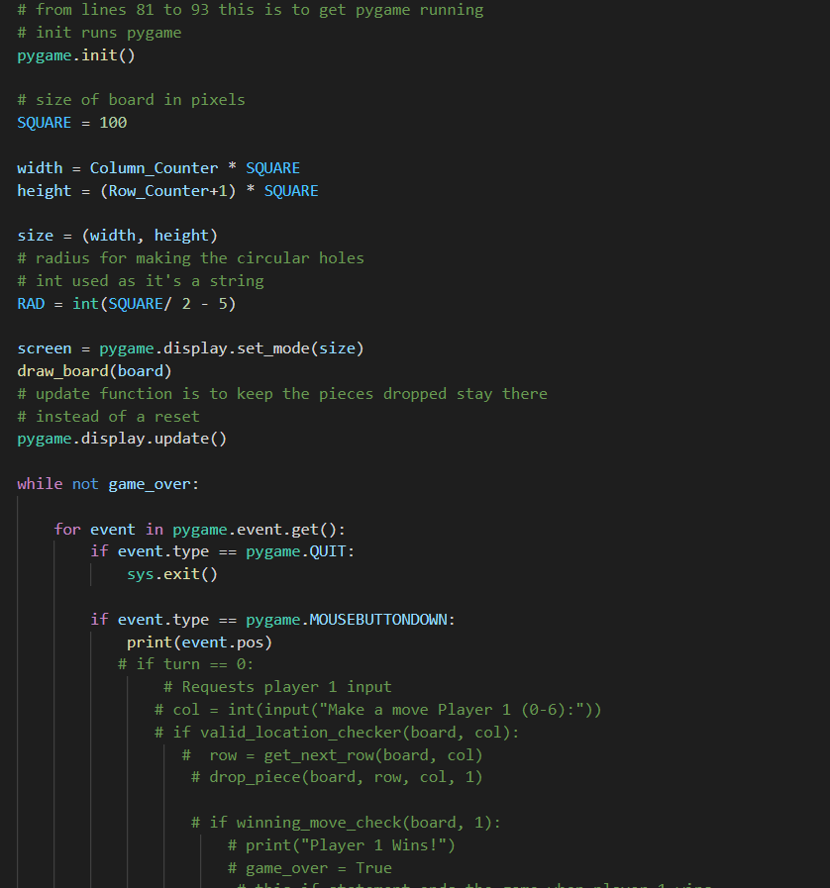
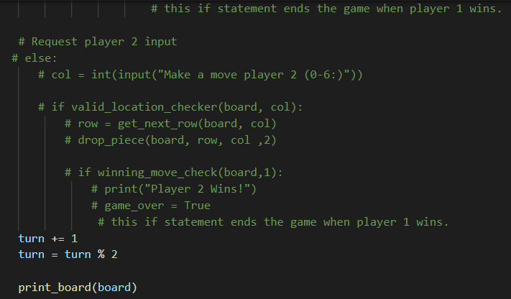
13th June Code Continued

Slide 44
Explanation For 2
With my planner, I am able to keep track how much I’ve done and allowing me to make certain versions as I go. In comparison with the code from the tenth versus the thirteenth of June, the 13th version has more progress unlike the tenth where it has slightly less. Thanks to my planner, it feels really easy being able to do version control as well.

Slide 45
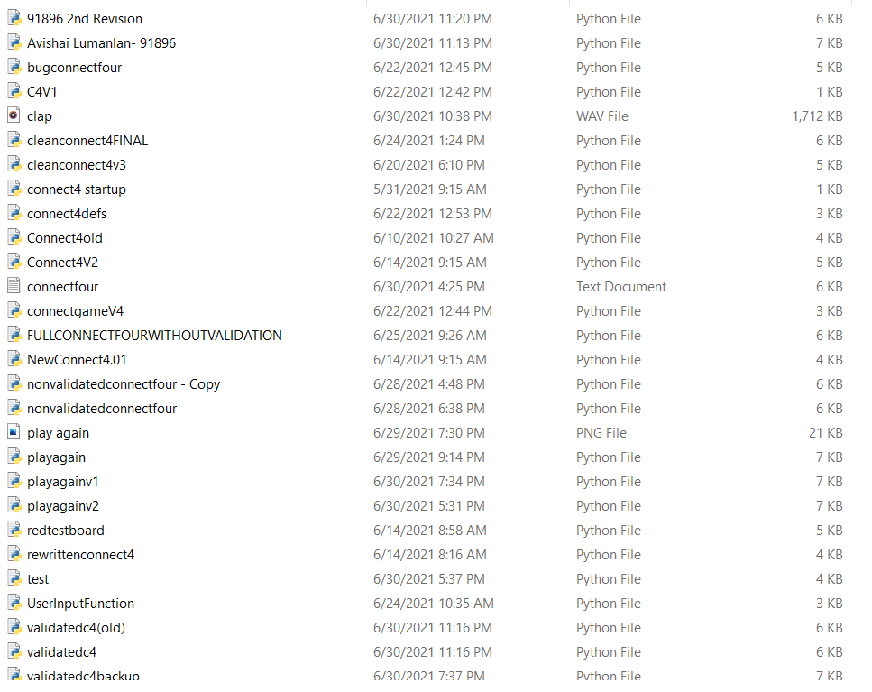
3.https://streamable.com/ztav7o

Slide 46
Explanation/Justification
With version control, I just saved all the versions of my code in a file. I found this easier to do as the dates were displayed on each file hence making it easy to backtrace which file corresponds to the time frame/date and major/sub component in my plan and to take evidence of.

Slide 47
Version Control
Your version control evidence should go here. This could be in the form of annotated screenshots which show you you managed this process or you could make a brief screencast explaining how you implemented version control.

Slide 48
Versions File

Slide 49
Version Screencast
https://streamable.com/ztav7o

Slide 50
Justification on Version Control
The method for version control while making my program is just by saving multiple versions of my code as I go along. I used this method because it was simple to do, and I do not know how to use github or pycharm for example as version control due to time management. With every major change or error that’s found, I save that version and carry on to a new file that would be an improved game. Another reason I used this method is because just by saving computer files, the dates are displayed for when I saved so it helps me for which version is which and which file is oldest.

Slide 51
Relevant Implications
Explain the relevant implications here. Please watch this video to learn how to do this.
Explain the Implications that are relevant to your outcome.
Record evidence that you have addressed the Implications that are relevant to your outcome.
1.Legal (implementing the use of Microsoft VSC)
2. Usability (easy to use)
3. Functionality (easy to play and understand)
4. Aesthetics

Slide 52
Legal
The first implication that relates to my project is the legality of my game. This is because prior to the creation of my game, I had to choose a software free of use to ensure no problems can be taken into court. So, I used microsoft visual studio code because it is a popular, free application and is compatible with other programming languages so I decided to make my game using this app. Another reason I chose visual studio code is because of the features it gives. For example, it has a terminal which is used to install support modules for python. With it, I was able to make the game the way I wanted it to be by installing modules such as pygame and pylint. Pygame is to convert the “txt” formatted code into a GUI based game and pylint was for fixing the variable errors I initially had.

Slide 53
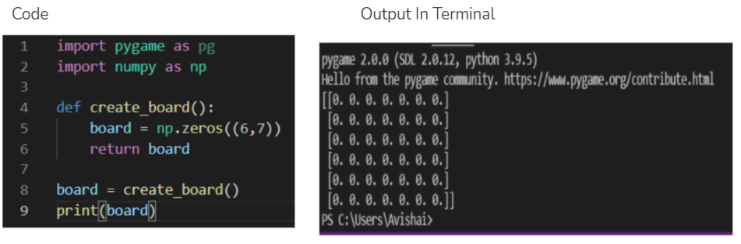
Legal Implication Evidence
Clean Code Evidence:
https://streamable.com/stfnyf
Old Code Evidence:
https://streamable.com/afmgex

Slide 54
Flexibility of VSC evidence
https://streamable.com/gnfnzw

Slide 55
Legal Evidence Justification
Again, my screen recordings just show that visual studio code ix flexible, it is also free and easy to use. I could have used other apps like pycharm, or python itself but I preferred visual studio as I found it easier to use because if I used pycharm for instance, I would have to pay if I wanted the full version forcing me to use the limited community edition type unlike visual studio where its a free app.

Slide 56
2. Usability
This is another implication I really wanted to take into account when making my game because a good game in terms of usability should be described as easy to understand the functions, movements, and how the full game is being played out fully. I addressed this by firstly, choosing a simple game to create (connect 4) and naming the defined functions, variables, strings and constants in a logical sense e.g. winning move check, print board, get next row, draw board, RAD.
Final Version of Code Shows this- https://streamable.com/juo8vn

Slide 57
3. Functionality
Functionality is one of the most important implications to address while making my project because a good game is working and ethical with no convention errors or in game errors whether that would be major or minor type of error, this is really important for me as my game is being coded, converted and played out in a GUI format. I addressed this implication during the development process of my game where I consistently tested and trialled my code multiple times in search for any errors that I’ll have to eliminate.

Slide 58
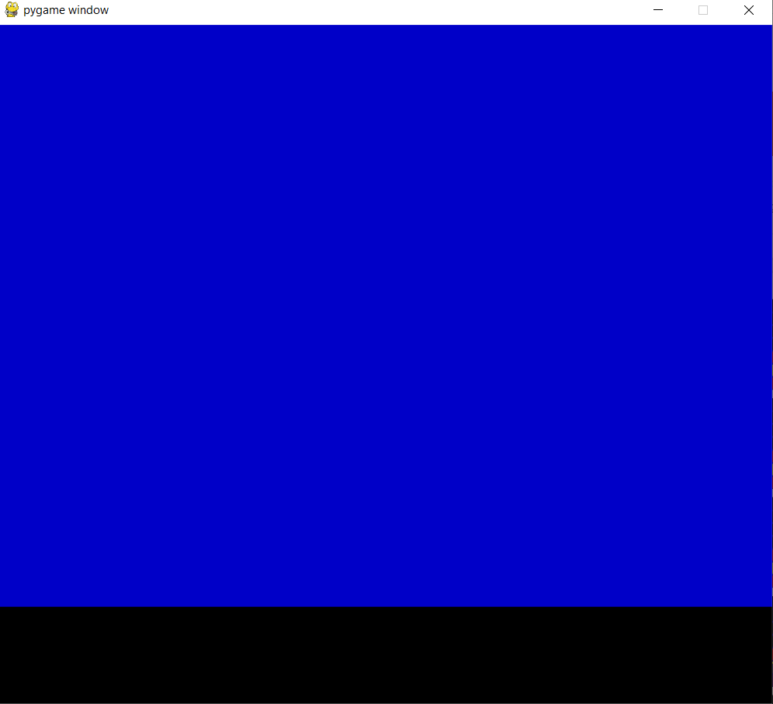
Functionality Evidence
Here is what my pygame used to show
While its running.

Slide 59
Another error is where I called
A variable to be true that was
Meant to be run inside the def
loop

Slide 60
https://streamable.com/1xpmyo

Slide 61
Here is a list of the convention errors
I ran into. This was done when I
Finished coding for the winning move
Check function.

Slide 62
4. Aesthetics
Aesthetics is the last implication that I felt the need to address. This is because of my game, connect four, I did not want my game to look like the real life rendition as that would be intellectual property. So, as a result I change the feel of the game to my own liking by prior coding. This was done and addressed by changing the initial board colours from the standard blue, yellow and red pieces, to an orange board, black background, and blue and green pieces.
Game Before- https://streamable.com/1xpmyo
Current Game - https://streamable.com/zkqvkq

Slide 63
Evaluate Discuss how the information from planning, testing and trialling of components assisted in the development of a high-quality outcome.
I used Monday for planning my time management and for breaking the game down into major and sub components as I kept on updating it every time I complete a section of code. Using Monday heavily assisted me because it helps me to remind myself of where I was up to and what parts of the game I still have to complete and how long I should work on a certain component of my project. As a result for me using Monday, I was able to be efficient in managing my time and keeping up to date as much as possible so I can comply with the plan and steps I set out for the development and evidence processes of my game.
Trialling was done with my family members for stakeholder feedback and further improvement. The information I got from them is what they think I should do and the types of features I should add to further improve my game and the way I code it as well. And as a result, it allowed me to take a bigger step for me find more errors that were in my game and find weak points in my code to improve in to make it easier to understand, play, and use with anyone, whether if it was friends or family.
With testing, I made sure to constantly test my code whenever I make changes and validate them to make sure that my work is completed ethically and logically. And from testing, I discovered that I can play around with the game code by altering the colors to my liking and potentially testing for other features that I could add like a play again function for example. And with testing, this made my code has become more tidy, easy to understand the functions, strings, commands, color constants, only left with a few validation/ convention errors

